Slide 1
ASP.NET Web API - BASIC
Jack Tsai

Slide 2
Agenda
What is Web API?
Creating Web API
Creating Web API Client
How it works?
Routing and Action
Model Validation
Media Formatting
Limitations

Slide 3
What is Web API?
Web Service Framework
RESTful
  HTTP
    GET: query, select, list, …
    POST: add, insert, …
    PUT: update, …
    DELETE: remove, kill, …
  URI
    http://service.yahoo.com/products/
    http://service.yahoo.com/products/3c
HTTP Service
Notes:
Web API 其實是 web service 的一種，什麼東西叫 web service？
就是提供給程式用的服務，所以它沒有所謂的 UI。
我們常見的 web service 有：
傳統的 web service (.asmx)。
WCF (.svc)。
這邊要順便跟大家介紹一下什麼是 RESTful，REST是一種設計風格而不是標準。
REST 通常基於使用 HTTP, URI 這些廣泛流行的協議和標準來實作。
回傳的不是完整的 HTML 網頁，而是根據不同的 HTTP method 回應結果。

Slide 4
Creating Web API
Prerequisites
  Visual Studio 2010 or above.
  ASP.NET MVC 4 http://www.asp.net/web-api

Slide 5
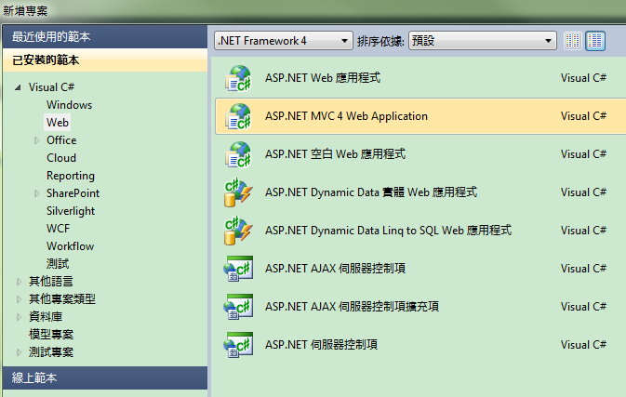
Creating Web API

Slide 6
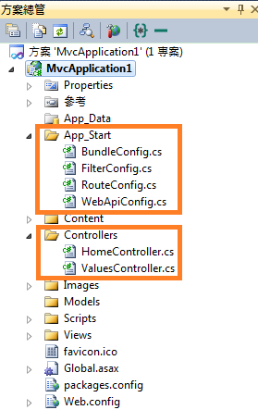
Creating Web API

Slide 7
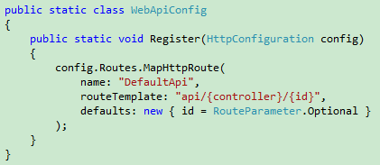
Creating Web API

Slide 8
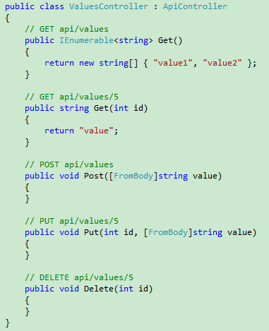
Creating Web API

Slide 9
Creating Web API Client
From a web browser
  Javascript – AJAX
    jQuery

Slide 10
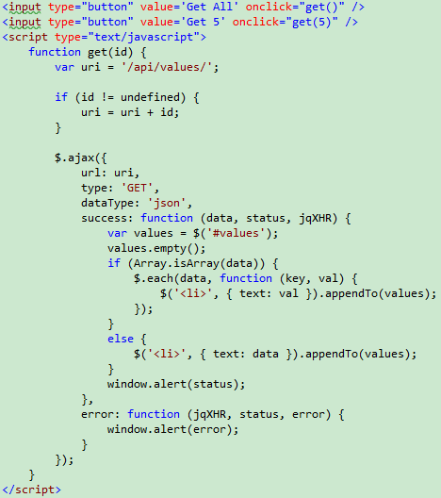
Creating Web API Client

Slide 11
Creating Web API Client
From a .NET Client
  System.Net.Http.HttpClient

Slide 12
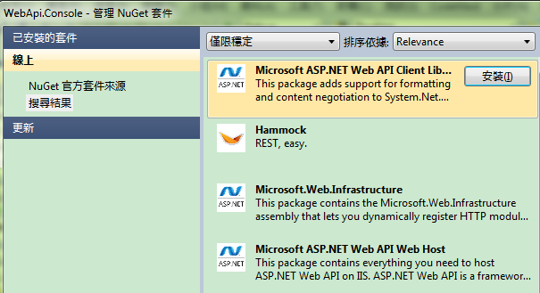
Creating Web API Client

Slide 13

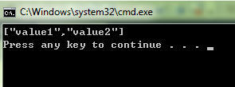
Creating Web API Client

Slide 14
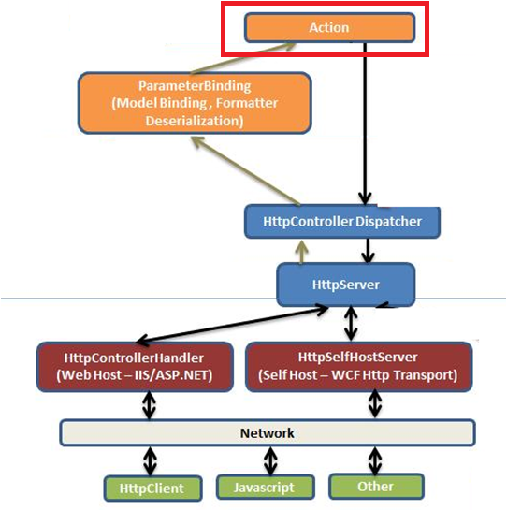
How it works?

Slide 15
Routing and Action
Controller Selection
URI | HTTP Controller
api/values | ValuesController VaLuEsController
api/products | productscontroller
api/company | comPANYconTroller
PS: Case insensitive

Slide 16
Routing and Action
Action Selection
HTTP Method | URI | Action | Parameter
GET | api/values | Get
GET | api/values/1 | Get | id = 1
POST | api/values | Put
PUT | api/values/3 | Put | id = 3
DELETE | api/values/5 | Delete | id = 5
POST | api/values/9 | (no match)

Slide 17
Routing and Action
Action Selection
  HTTP Methods
    Decorating HttpGet, HttpPut, HttpPost or HttpDelete attribute.
    Decorating AcceptVerbs attribute.
      [AcceptVerbs(“GET”)]
      [AcceptVerbs(“MKCOL”)]
    Decorating ActionName attribute.
      [ActionName(“MyAction1”)]

Slide 18
Routing and Action
Action Selection
  Routing by Method Name
Method Name | HTTP Method
GetXXX | GET
PostYYY | POST
… | …

Slide 19
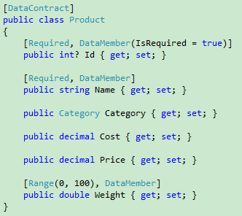
Model Validation
Using System.Runtime.Serialization
Using System.ComponentModel.DataAnnotations

Slide 20
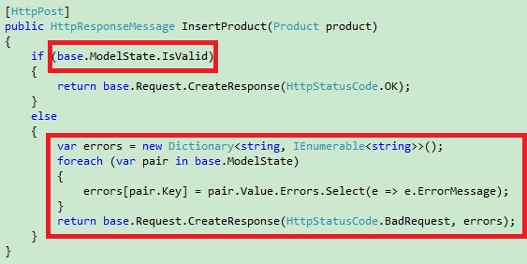
Model Validation

Slide 21
Media Formatting
HTTP Header
  Accept
    告訴 server 我接受哪些類型的資料格式。
  Content-Type
    Client 告訴 server 傳出去的資料格式。
    Server 告訴 client 傳回來的資料格式。
  text/html
  text/json
  application/html
  applicaton/json
  application/x-www-form-urlencoded

Slide 22
Media Formatting
Default Media Formatters
  JsonMediaTypeFormatter
    application/json
    text/json
  XmlMediaTypeFormatter
    application/xml
    text/xml
  FormUrlEncodedMediaTypeFormatter
    application/x-www-form-urlencoded
  JQueryMvcFormUrlEncodedFormatter
    application/x-www-form-urlencoded

Slide 23
Media Formatting
Customize Media Formatter
  Derive from
    MediaTypeFormatter - asynchronous
    BufferedMediaTypeFormatter - synchronous

Slide 24
Limitations
HTTP GET 不能用 request body 傳資料。
  Protocol Specification?
Default Controller Naming
  Must suffix with ‘Controller’.
Default Parameter Bindings
  Simple types are taken from the URI.
    Includes all of .NET primitive types
    Plus DateTime, Decimal, Guid, String and TimeSpan.
  Complex types are taken from the request body.
    At most ONE.

Slide 25
Q&A

Slide 26
References
http://www.asp.net/web-api

